Slide 1
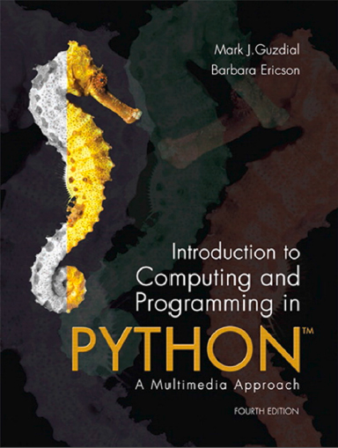
Introduction to Computing and Programming in Python™: A Multimedia Approach
Fourth Edition
Chapter 7
Modifying Sounds Using Loops
Copyright © 2016, 2013, 2010 Pearson Education, Inc. All Rights Reserved
Notes:
If this PowerPoint presentation contains mathematical equations, you may need to check that your computer has the following installed:
1) MathType Plugin
2) Math Player (free versions available)
3) NVDA Reader (free versions available)

Slide 2
Learning Objectives (1 of 2)
7.1 To understand how we digitize sounds, and the limitations of human hearing that allow us to digitize sounds.
7.2 To use the Nyquist theorem to determine the sampling rate necessary for digitizing a desired sound.
7.3 To manipulate volume.
7.4 To create (and avoid) clipping.

Slide 3
Learning Objectives (2 of 2)
7.5 To understand and use arrays as a data structure.
7.6 To use the formula that n bits result in 2^{n} possible patterns in order to ﬁgure out the number of bits needed to save values.
7.7 To use the sound object.
7.8 To debug sound programs.
7.9 To use iteration (in for loops) for manipulating sounds.
7.10 To use scope to understand when a variable is available for use.

Slide 4
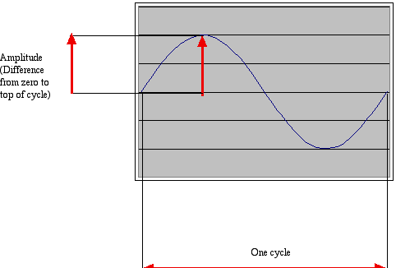
How Sound Works: Acoustics, the Physics of Sound
Sounds are waves of air pressure
Sound comes in cycles
The frequency of a wave is the number of cycles per second (cps), or Hertz
Complex sounds have more than one frequency in them.
The amplitude is the maximum height of the wave

Slide 5
Volume and Pitch: Psychoacoustics, the Psychology of Sound
Our perception of volume is related (logarithmically) to changes in amplitude
If the amplitude doubles, it’s about a 3 decibel (deciBel) change
Our perception of pitch is related (logarithmically) to changes in frequency
Higher frequencies are perceived as higher pitches
We can hear between 5 Hertz and 20,000 Hertz (20 kiloHertz)
A above middle C is 440 Hertz

Slide 6
“Logarithmically?”
It’s strange, but our hearing works on ratios not differences, e.g., for pitch.
We hear the difference between 200 Hertz and 400 Hertz, as the same as 500 Hertz and 1000 Hertz
Similarly, 200 Hertz to 600 Hertz, and 1000 Hertz to 3000 Hertz
Intensity (volume) is measured as watts per meter squared
A change from 0.1W/m2 to 0.01 W/m2, sounds the same to us as 0.001W/m2 to 0.0001W/m2

Slide 7
Decibel is a Logarithmic Measure
A decibel is a ratio between two intensities:
As an absolute measure, it’s in comparison to threshold of audibility
0 deciBel can’t be heard.
Normal speech is 60 deciBel.
A shout is about 80 deciBel

Slide 8
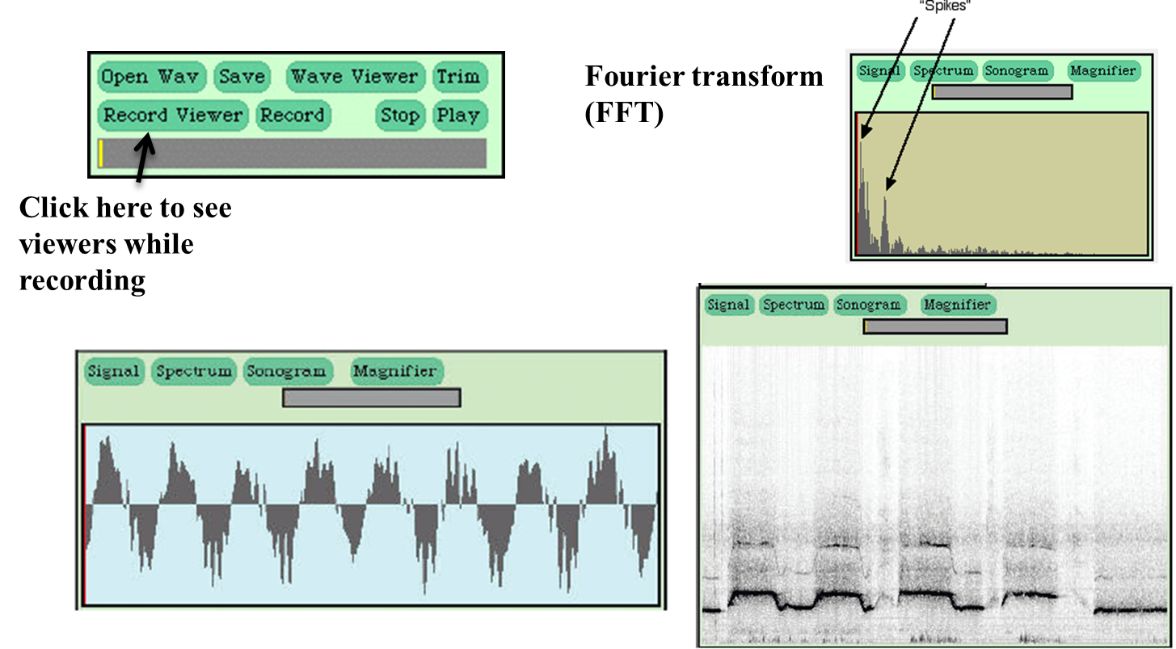
Demonstrating Sound Mediatools
Notes:
I usually bring in a couple musical instruments (harmonica, thumb piano, ukelele, flute) to show how they have different FFT “signature” (different spikes).

Slide 9
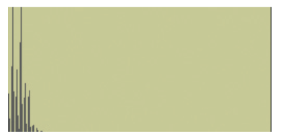
Singing in the Frequency Domain
Figure 7.8 A sung note in a spectrum view.

Slide 10
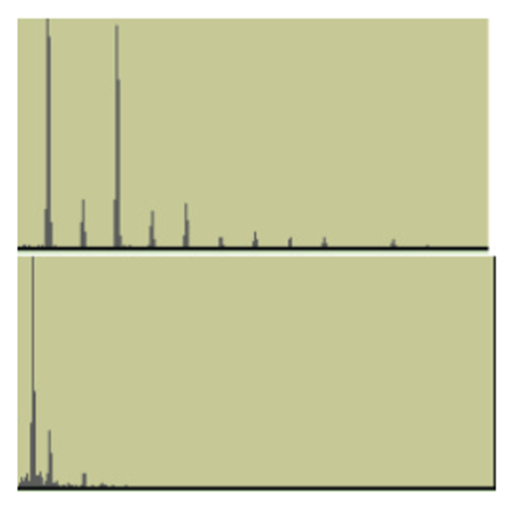
Other Instruments in F F T
Figure 7.9 Harmonica and Ukulele notes in a spectrum view.

Slide 11
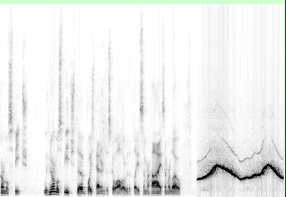
Normal Speech and Whistle in Sonogram View

Slide 12
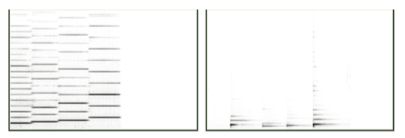
Harmonica and Ukulele in Sonogram
Figure 7.11 Viewing harmonica (left) and ukulele (right) notes in a sonogram view.

Slide 13
Digitizing Sound: How Do We Get That into Numbers?
Remember in calculus, estimating the curve by creating rectangles?
We can do the same to estimate the sound curve
Analog-to-digital conversion (A D C) will give us the amplitude at an instant as a number: a sample
How many samples do we need?

Slide 14
Nyquist Theorem
We need twice as many samples as the maximum frequency in order to represent (and recreate, later) the original sound.
The number of samples recorded per second is the sampling rate
If we capture 8000 samples per second, the highest frequency we can capture is 4000 Hertz
That’s how phones work
If we capture more than 44,000 samples per second, we capture everything that we can hear (max 22,000 Hertz)
C D quality is 44,100 samples per second

Slide 15
Digitizing Sound in the Computer
Each sample is stored as a number (two bytes)
What’s the range of available combinations?
16 bits, 216 = 65,536
But we want both positive and negative values
To indicate compressions and rarefactions.
What if we use one bit to indicate positive (0) or negative (1)?
That leaves us with 15 bits
15 bits, 215 = 32,768
One of those combinations will stand for zero
We’ll use a “positive” one, so that’s one less pattern for positives

Slide 16
Two’s Complement Numbers
011 | +3 | Imagine there are only 3 bits
010 | +2 | we get 2 cubed = 8 possible values
001 | +1 | Subtracting 1 from 2 we borrow 1
000 | 0 | blank
111 | −1 | Subtracting 1 from 0 we borrow 1’s
110 | −2 | which turns on the high bit for all
101 | −3 | negative numbers
100 | −4 | blank

Slide 17
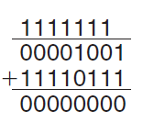
Two’s Complement Numbers Can Be Simply Added
Adding −9 (11110111) and 9 (00001001)

Slide 18
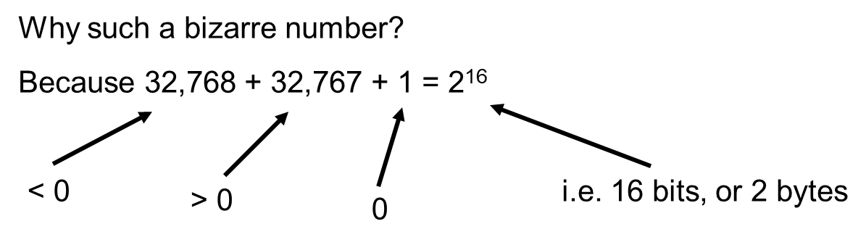
Illustration of fraction displays plus over minus 32 K
Each sample can be between −32,768 and 32,767
Compare this to 0...255 for light intensity
(i.e. 8 bits or 1 byte)

Slide 19
Sounds as Arrays
Samples are just stored one right after the other in the computer’s memory
(Like pixels in a picture)
That’s called an array
It’s an especially efficient (quickly accessed) memory structure

Slide 20
Working with Sounds
We’ll use pickAFile and makeSound.
We want .wav files
We’ll use getSamples to get all the sample objects out of a sound
We can also get the value at any index with getSampleValueAt
Sounds also know their length (getLength) and their sampling rate (getSamplingRate)
Can save sounds with writeSoundTo(sound, “file.wav”)

Slide 21
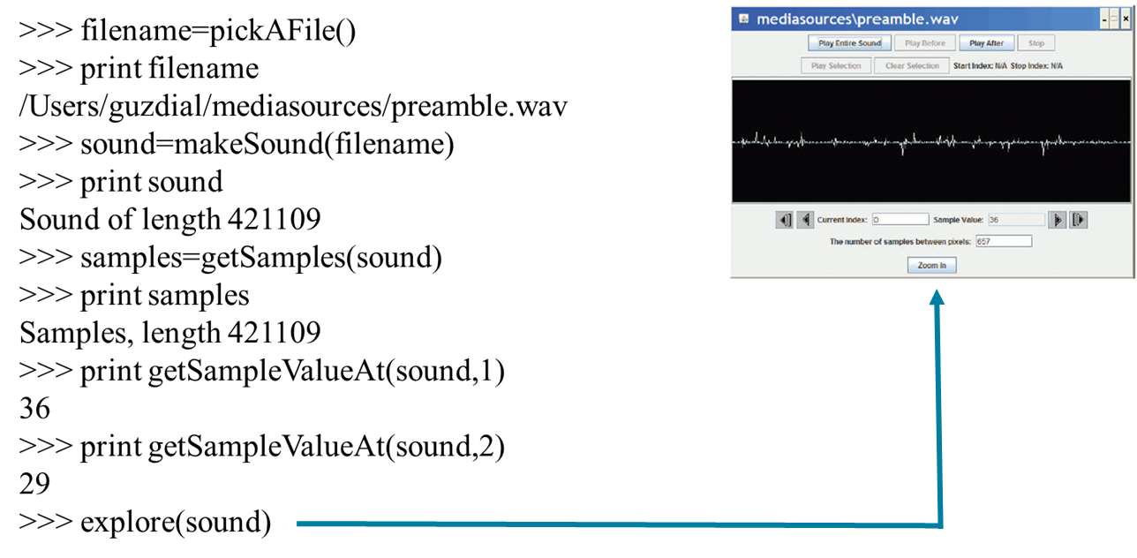
Demonstrating Working with Sound in J E S

Slide 22
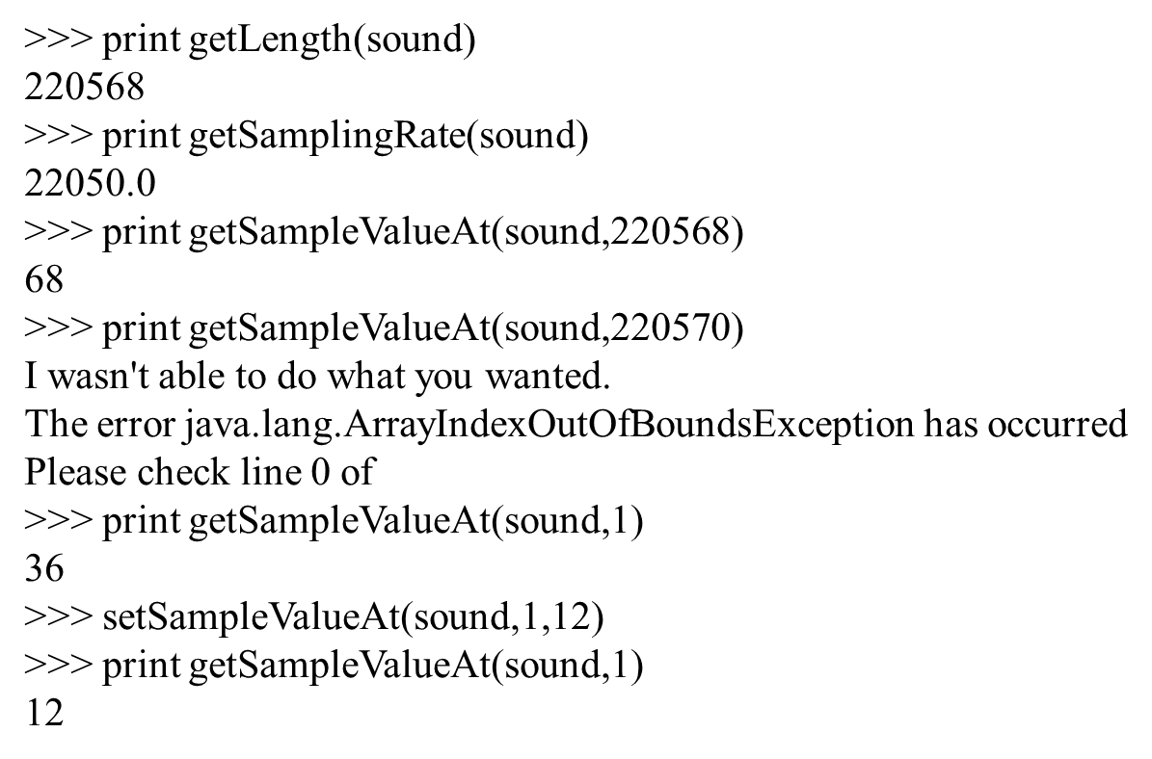
Demonstrating Working with Samples

Slide 23
Working with Samples
We can get sample objects out of a sound with getSamples(sound) or getSampleObjectAt(sound,index)
A sample object remembers its sound, so if you change the sample object, the sound gets changed.
Sample objects understand getSample(sample) and setSample(sample,value)

Slide 24
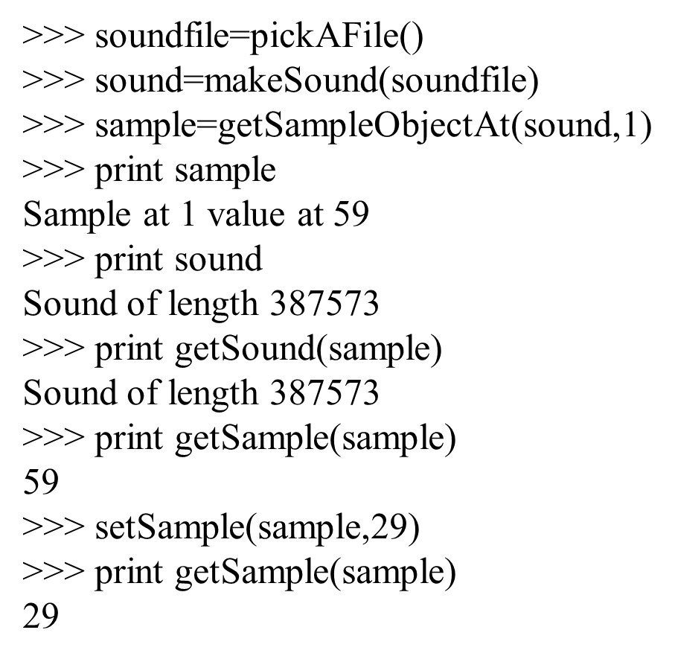
Example: Changing Samples

Slide 25
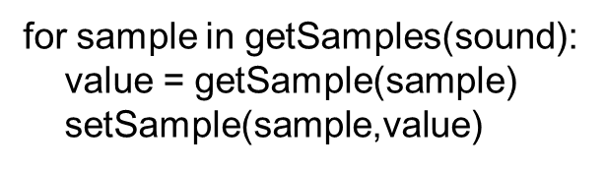
“But There Are Thousands of These Samples!”
How do we do something to these samples to manipulate them, when there are thousands of them per second?
We use a loop and get the computer to iterate in order to do something to each sample.
An example loop:

Slide 26
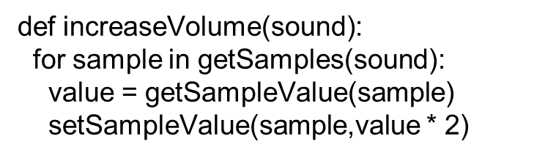
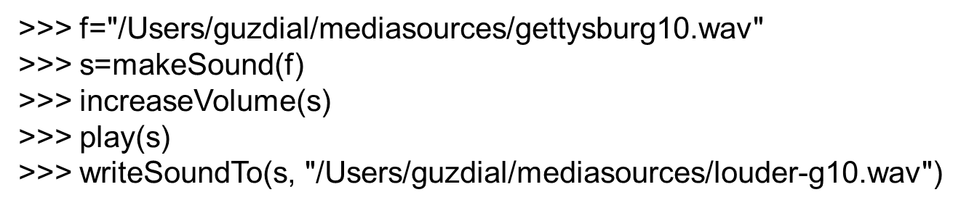
Recipe to Increase the Volume
Using it:

Slide 27
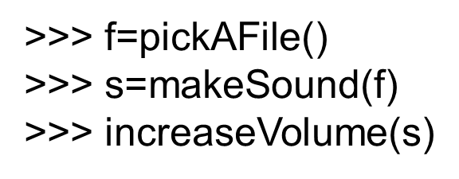
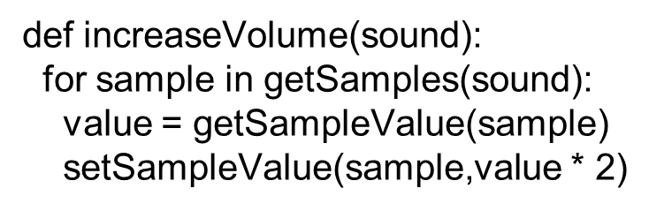
How Did That Work?
When we evaluate increaseVolume(s), the function increaseVolume is executed
The sound in variable s becomes known as sound
sound is a placeholder for the sound objects.

Slide 28
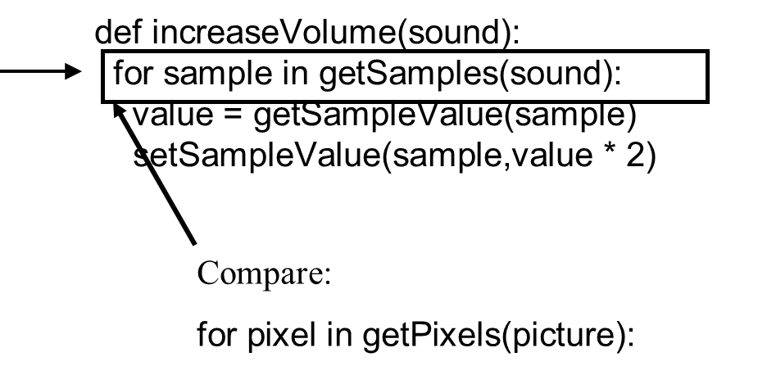
Starting the Loop
getSamples(sound) returns a sequence of all the sample objects in the sound.
The for loop makes sample be the first sample as the block is started.

Slide 29
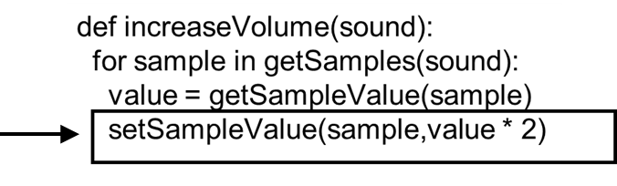
Executing the Block
We get the value of the sample named sample.
We set the value of the sample to be the current value (variable value) times 2

Slide 30
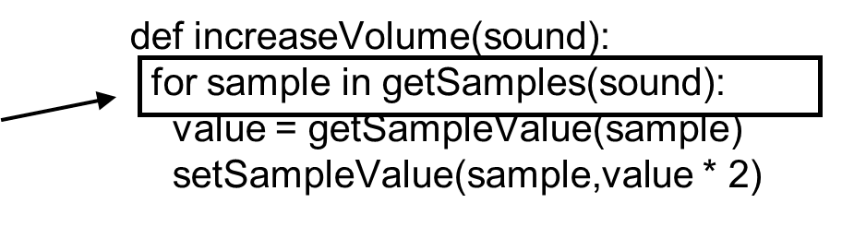
Next Sample
Back to the top of the loop, and sample will now be the second sample in the sequence.

Slide 31
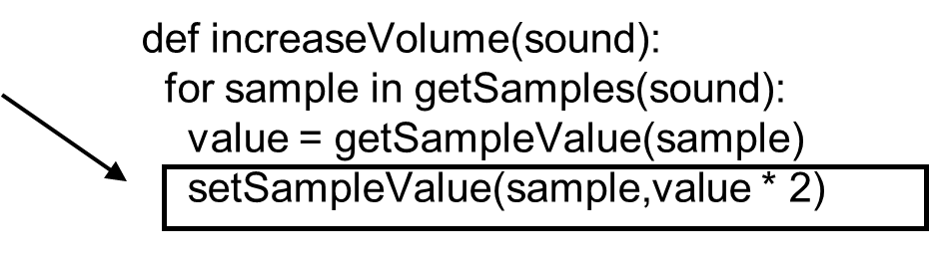
And Increase That next Sample
We set the value of this sample to be the current value (variable value) times 2.

Slide 32
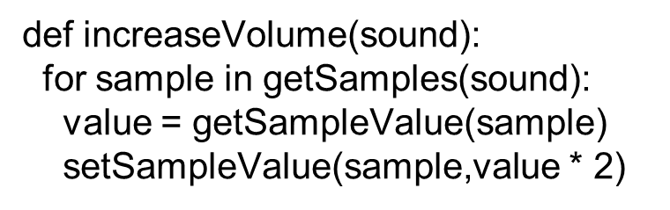
And on Through the Sequence
The loop keeps repeating until all the samples are doubled

Slide 33
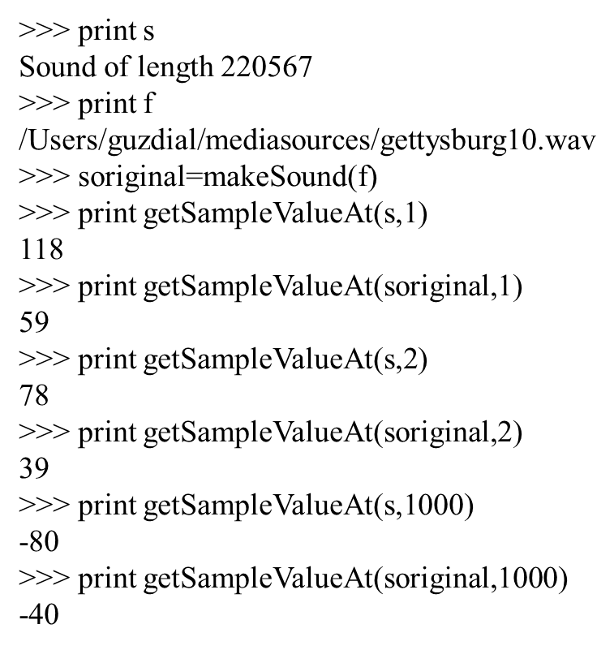
How Are We Sure That That Worked?
Here we’re comparing the modified sound s to a copy of the original sound soriginal

Slide 34
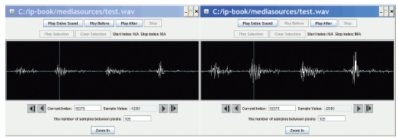
Exploring Both Sounds
The right side does look like it’s larger.

Slide 35
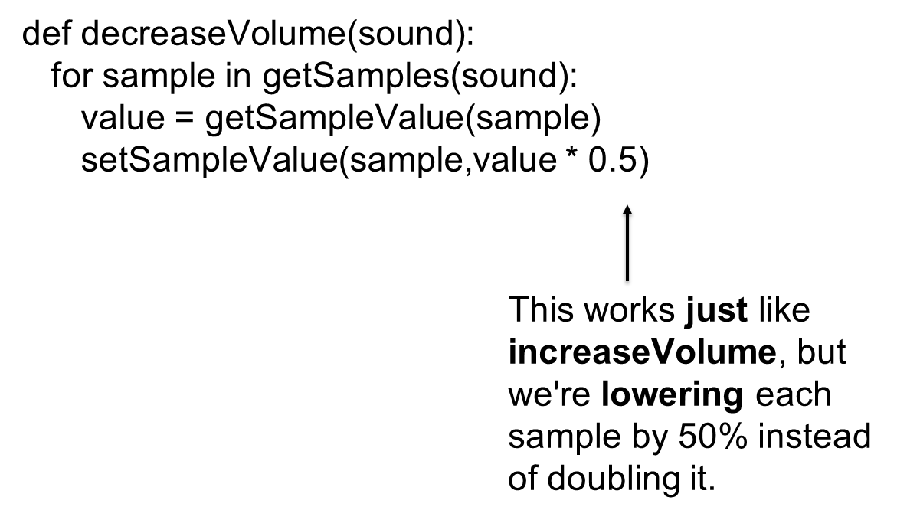
Decreasing the Volume
Notes:
Be sure to actually do this!

Slide 36
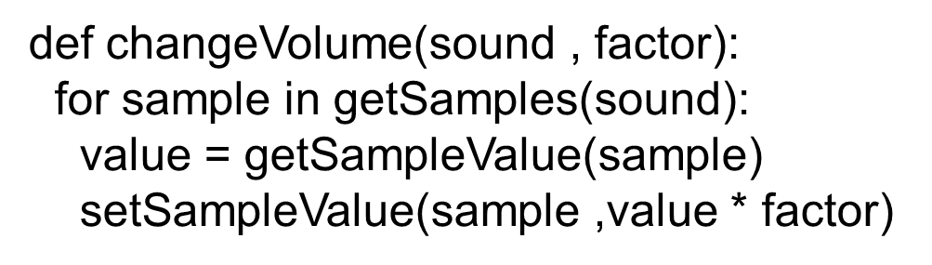
We Can Make This Generic
By adding a parameter, we can create a general changeVolume that can increase or decrease volume.

Slide 37
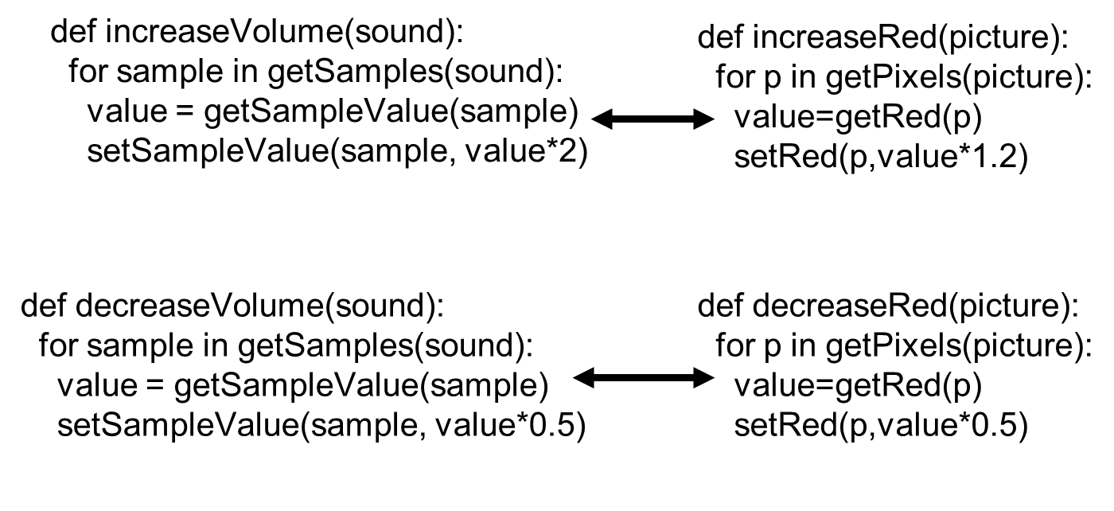
Recognize Some Similarities?

Slide 38
Does Increasing the Volume Change the Volume Setting?
No
The physical volume setting indicates an upper bound, the potential loudest sound.
Within that potential, sounds can be louder or softer
They can fill that space, but might not.
(Have you ever noticed how commercials are always louder than regular programs?)
Louder content attracts your attention.
It maximizes the potential sound.

Slide 39
Maximizing Volume
How, then, do we get maximal volume?
(e.g. automatic recording level)
It’s a three-step process:
First, figure out the loudest sound (largest sample).
Next, figure out how much we have to increase/decrease that sound to fill the available space
We want to find the amplification factor amp, where amp * loudest = 32767
In other words: amp = 32767/loudest
Finally, amplify each sample by multiplying it by amp

Slide 40
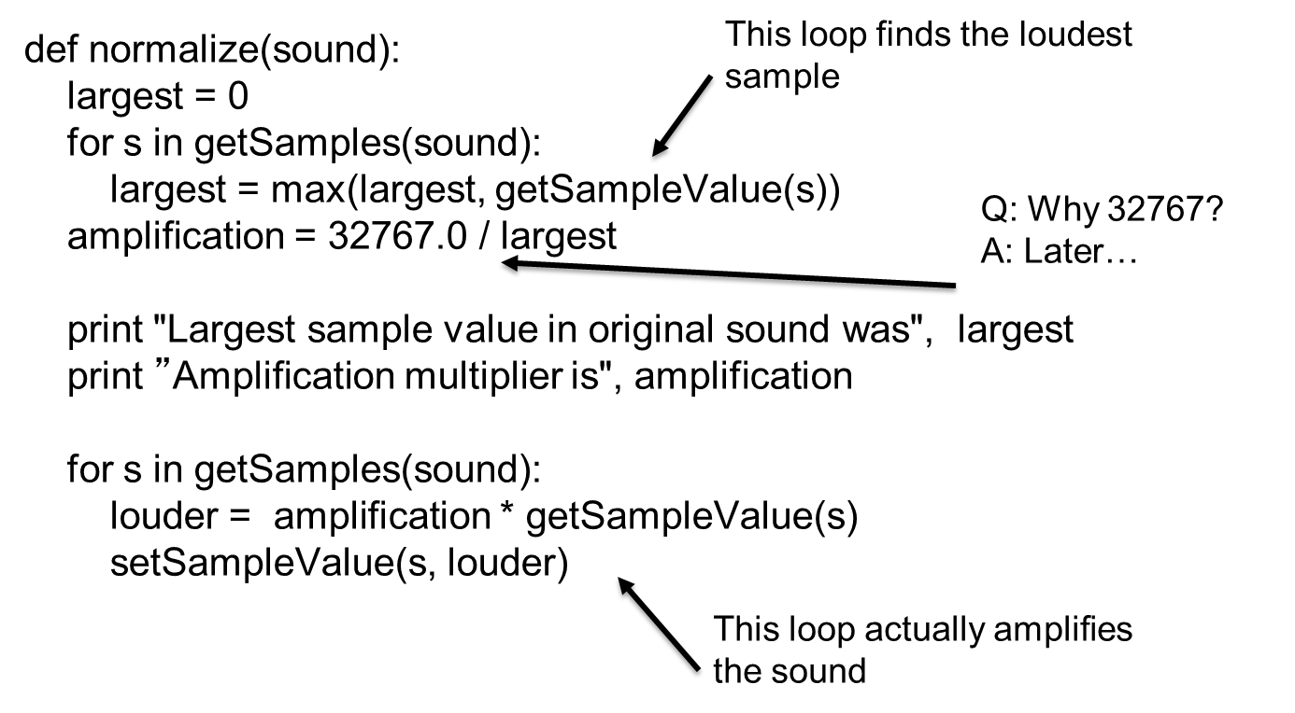
Maxing (Normalizing) the Sound

Slide 41
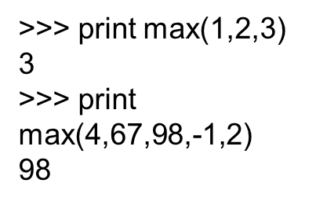
Max()
max() is a function that takes any number of inputs, and always returns the largest.
There is also a function min() which works similarly but returns the minimum

Slide 42
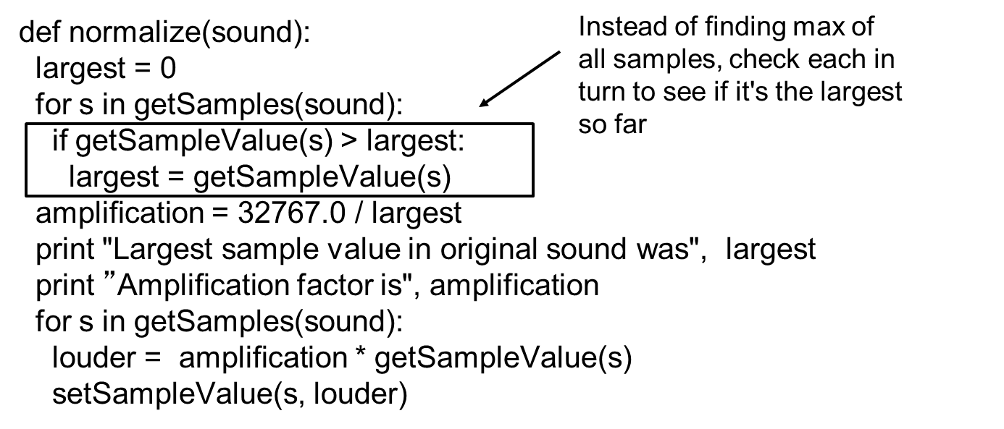
Or: Use If Instead of Max

Slide 43
Aside: Positive and Negative Extremes Assumed to Be Equal
We’re making an assumption here that the maximum positive value is also the maximum negative value.
That should be true for the sounds we deal with, but isn’t necessarily true
Try adding a constant to every sample.
That makes it non-cyclic
I.e. the compressions and rarefactions in the sound wave are not equal
But it’s fairly subtle what’s happening to the sound.

Slide 44
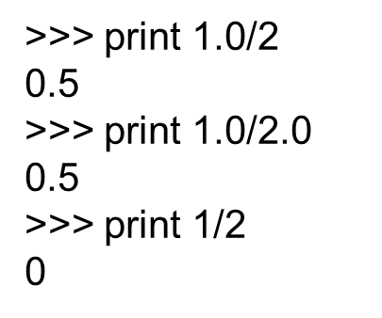
Why 32767.0, Not 32767?
Why do we divide out of 32767.0 and not just simply 32767?
Because of the way Python handles numbers
If you give it integers, it will only ever compute integers.

Slide 45
Avoiding Clipping
Why are we being so careful to stay within range? What if we just multiplied all the samples by some big number and let some of them go over 32,767?
The result then is clipping
Clipping: The awful, buzzing noise whenever the sound volume is beyond the maximum that your sound system can handle.
Notes:
Be sure to generate some clipping here!

Slide 46
What If We Maximized the Sound?
All samples over 0: Make it 32767
All samples at or below 0: Make it -32768

Slide 47
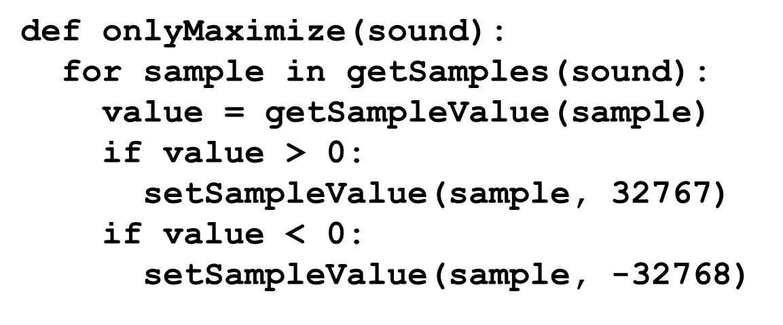
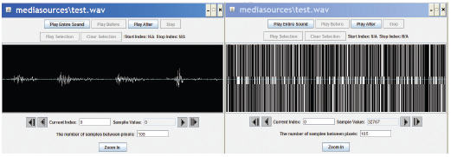
All Clipping, All the Time

Slide 48
We Can Hear the Speech!
Try it! You can understand speech in this mangled sound.
Why?
Implications:
Human understanding of speech relies more on frequency than amplitude.
Note how many bits we need per sample. A single bit per sample can record legible speech.

Slide 49
Processing Only Part of the Sound
What if we wanted to increase or decrease the volume of only part of the sound?
Q: How would we do it?
A: We’d have to use a range() function with our for loop
Just like when we manipulated only part of a picture by using range() in conjunction with getPixels()

Slide 50

Copyright

